Slide 1

CAS and its Cooperation with Belgium in
Space and Aeronautics
CAO Dianwen
Bureau of International Cooperation
Chinese Academy of Sciences (CAS)
30 March 2017

Slide 2




Chinese Academy of Sciences (CAS)
Scientific
Excellence
High-caliber
Talent
Trusted
Ideas
Mission
Staff: ~68,000
Graduates: ~53,000
CAS Members: 776
Foreign Members: 80
Budget : ~USD 7 Billion
3 Universities
Academy
Structure
104 Institutes
Innovative Academies
Center of Excellence
Mega-science Research Centers
Feature Institutes
The lead national scientific institution in natural sciences and high tech and development in China and China’s supreme scientific advisory body

Slide 3
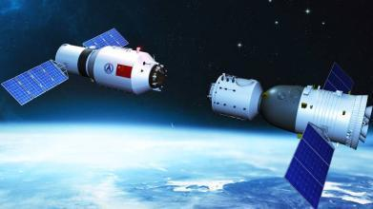
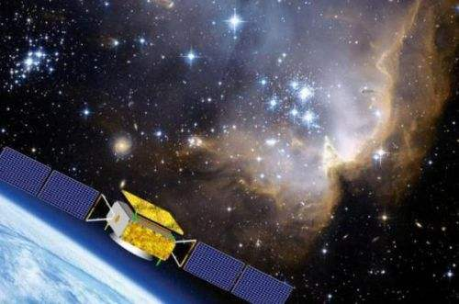
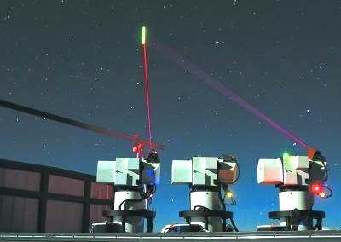
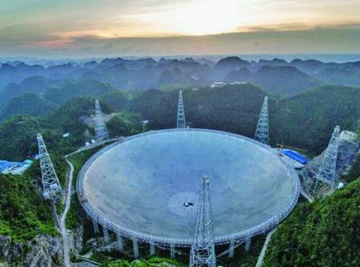
Highlights in space and aeronautics in 2016
Shenzhou-11 docks with Tiangong-2
Dark-matter satellite “Wukong”
Global network mode for Beidou Navigation Satellite System
Five-hundred-meter Aperture Spherical Radio Telescope
Quantum communication satellite
CAS research units for space and aeronautics
National Space Science Center
National Astronomical Observatories
Shanghai Engineering Center for Microsatellites
Institute of Remote Sensing and Digital Earth
Technology and Engineering Center For Space Utilization

Slide 4
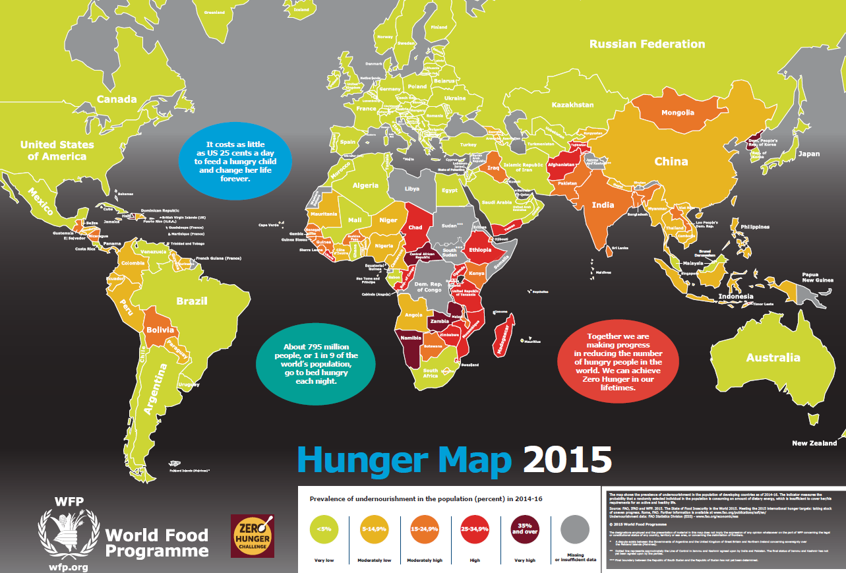

China-Belgium GLOVEG Earth Observation Mission
Challenges
Global food security, water crisis, global change and contribution to SDGs are common requirement for both China and Belgium/Europe. To cope with these challenges:
  Global perspective through international cooperation
  using earth observation technology to generate new products
  jointly release global monitoring information to increase credibility
Cooperation between China and Belgium/Europe will:
  Strengthen global monitoring capability
  Ensure data consistency in long term
  Promote innovative products and service
  Contribute to human being, particularly for food security and SDGs

Slide 5
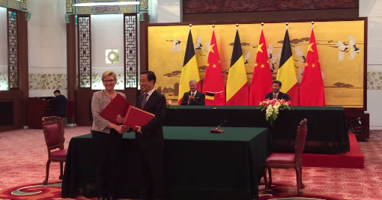
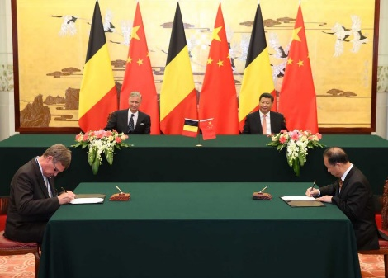
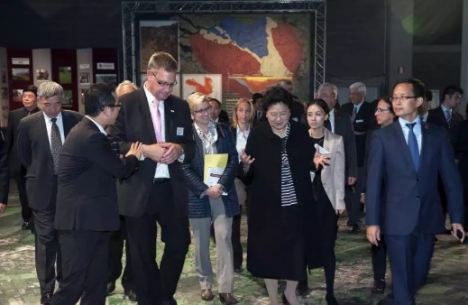
An area of attention for leadership of both sides
A high level MOU between CNSA and BELSPO was signed in June, 2015, witnessed by King Phillipe and President Xi Jinping.
A specific MOU and Mission Concept Document between RADI and VITO was signed in June, 2015, witnessed by King Phillipe and President Xi Jinping.
Chinese Vice Premier Liu Yandong listened to the briefing of Global-V in September,2015 and hopes it can be launched on time.
RADI/CAS & VITO have jointly developed the Mission Concept Report, User Requirement Document, Technical Document in the past 3 years through intensive communications, joint technical seminars and workshops.

Slide 6
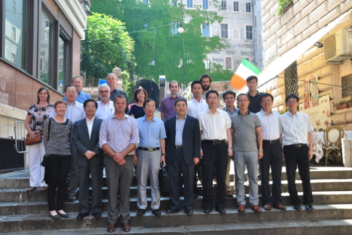
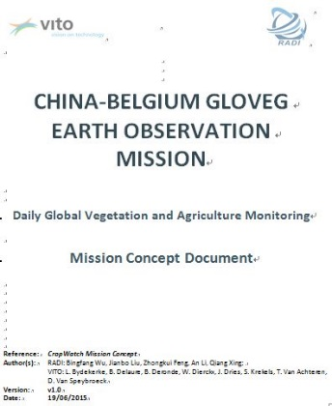
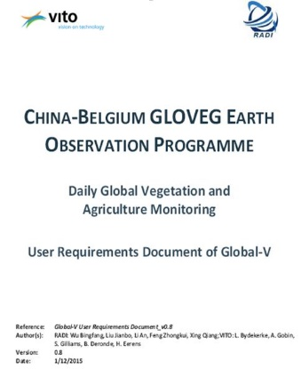
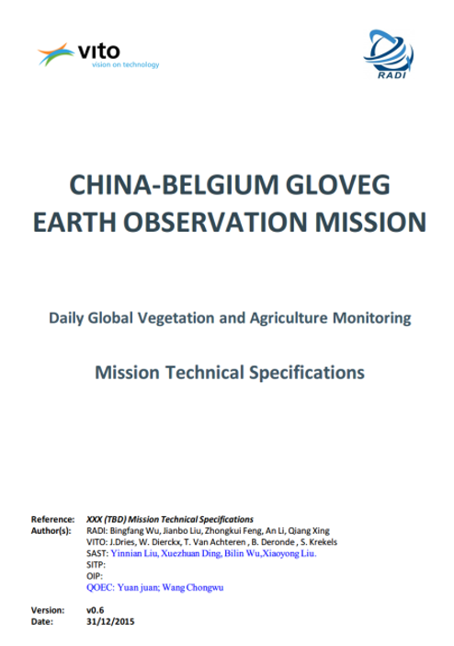
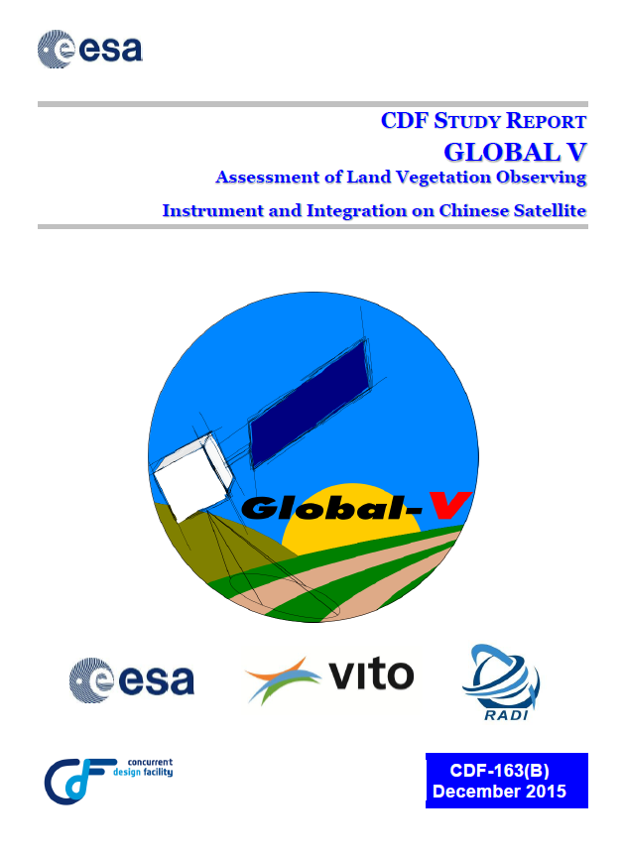
Progress
Mission concept design report, user requirement report and technical report have been prepared.
Mission has passed feasibility demonstration based on Concurrent Design Facility (CDF) of European Space Agency (ESA), with the conclusion that the Global-V mission program is feasible.
The Global-V mission is one of the 16 key tasks in 2016 by CNSA with a clear funding source.
CNSA made plan on securing funding for Global-V.
CNSA and BELSPO have established working group of China-Belgium space cooperation and formed communicating mechanism through video conference since 2016.

Slide 7
Pause in the process
The Belgian side informed in a sudden that ESA did not support Global-V mission between Belgium and China at the end of May, 2016.
Notes:
The cooperation between ESA and China must completely comply with the existing export control regulations of all member states and the United States, which is a pre-condition;
Therefore, ESA did not support the vegetation satellite cooperation between Belgium and China.

Slide 8
Prospective
  Feedback on China new proposed cooperation plan based on Mission Concept Document:
    China and Belgium each launches a satellite with consistent optical and thermal instruments
    China and Belgium each shares 50% of each satellite
Implement MOU and Mission Concept Document by starting formal official negotiations on:
    Detailed timing and budget plan
    Institution plan
  Making efforts to remove the barrier from ESA in order to start the mission which is beneficial for human being and both countries

Slide 9


CAS President’s International Fellowship Initiative(PIFI)
  Supports 30 leading international scientists to conduct a lecture tour at CAS for
  1-2 weeks.
  Stipend:￥50,000 per week, to cover all expenses for lecture tour
  Supports 200 international scientists to conduct joint research at CAS institutes for
  1-12 months.
  Monthly stipend:
  Full professor
  ￥40,000
  Associate professor: ￥30,000
  Assistant professor
  ￥20,000
  international round-trip
  Supports 100 young international posdocs to conduct research at CAS institutes for 1-2 years.
  Yearly stipend: ￥200,000
  international round-trip
  Supports 200 international graduates each year, to pursue their PhD degrees at UCAS and USTC
  Monthly tipend:
  ￥ 7,000-8,000
  international round-trip

Slide 10
Thank you for your attention！

